Slide 1
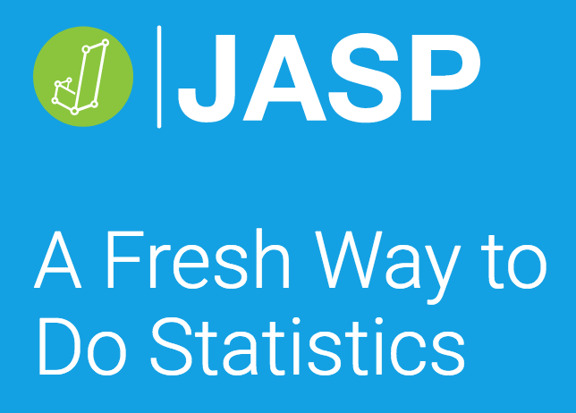

Slide 2
Outline
Help Desk, Blackboard, and other set up
Basic JASP – installation and other notes
Excel data management and manipulation
Pick your favorite t-test
Regression
ANOVA
Please interrupt, ask questions, make comments, and send feedback about the guides.

Slide 3
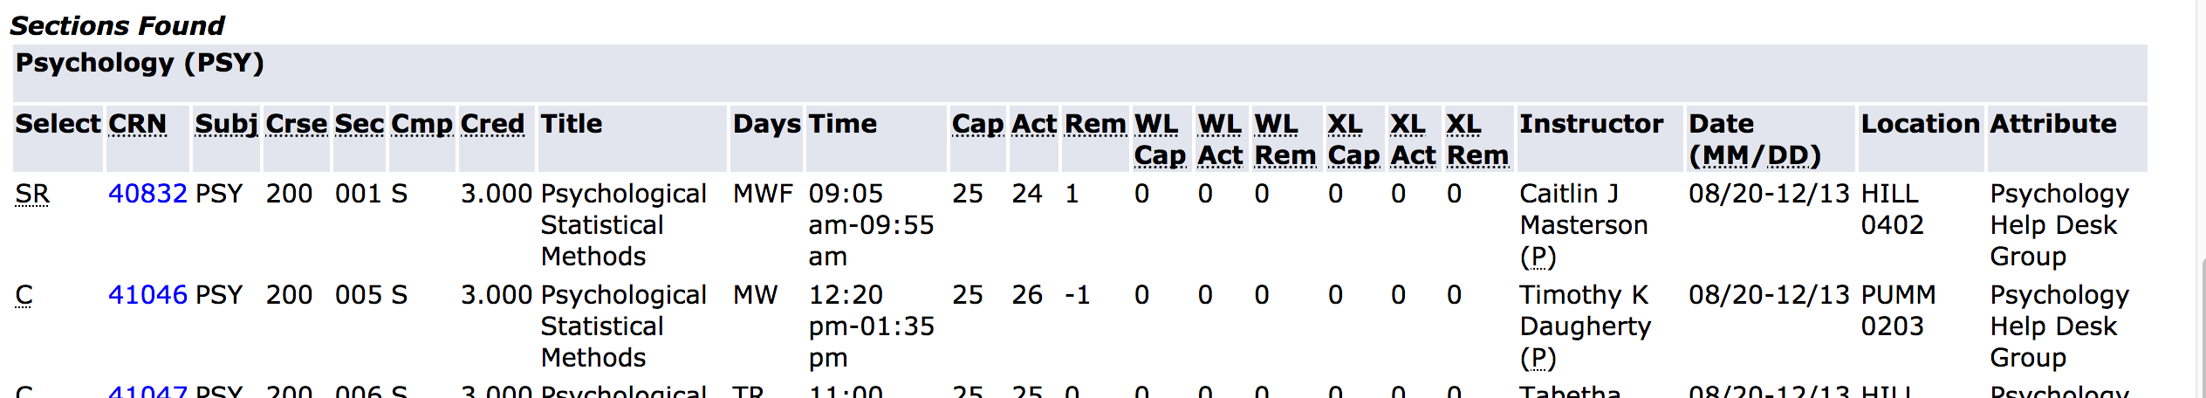
Help Desk
The Psych Help Desk:
A GA who offers designated times throughout the week for students to get help with statistics and research methods courses
A Blackboard portal that auto-enrolls students so we can connect to them
Covers PSY 200, 302, 527/627, 745, 751, 752

Slide 4
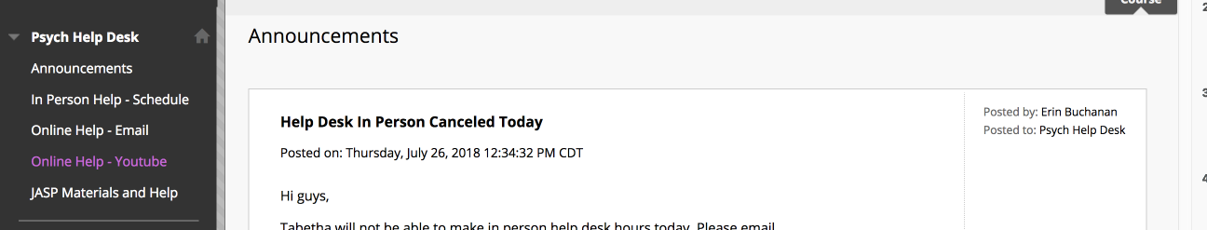
Help Desk
Check out the blackboard!
If you are not enrolled, please let me know and I can add you.
Allows for announcements, reminders, and links to the materials.

Slide 5
JASP Overview
Why JASP?
Very easy to use
Free
APA format output
Reproducible work
Where do I get JASP?
https://jasp-stats.org/

Slide 6
JASP Installation
All guides can be found at: https://osf.io/t56kg/
Let’s look at the installation guide
Windows, Mac, and Linux options
Macs are special
appRoll options for students with Chromebooks and iPads (note here about version)

Slide 7
JASP Use
Let’s look at the second set of guides
Opening files: Data Library versus Excel .csv
Left side is data or analysis, right side is output
Variable column types
Entering value labels
Important notes about homework submission (again, Macs are weird)
Saving the analyses so someone can help you .jasp files

Slide 8
Excel Integration
Guide #3 Excel overview
JASP uses Excel to edit
Remember, students get Office for free from the school
What is tidy data?
Be sure to use .csv format
The graphs in JASP are my one sad face

Slide 9
Guides for Statistical Tests
Each guide includes the following: (thanks Ruthie!)
Introduction to the test
Overview of assumptions
Null and alternative hypotheses
Example:
Data
How to test assumptions
How to run statistical test, effect size
Interpretation of these in line with statistical thinking
How to report
Feedback for guides is graciously taken! Link to OSF for the most up to date version.

Slide 10
Pick your favorite t-test!
Let’s check out how to run t-tests in JASP.

Slide 11
Regression
The regression guide has both simple and multiple linear regression. Let’s go over one of those.

Slide 12
ANOVA
Let’s look at the guide for the between subjects ANOVA.

Slide 13
Questions?
Other comments/questions/ideas that you have.

